Slide 1
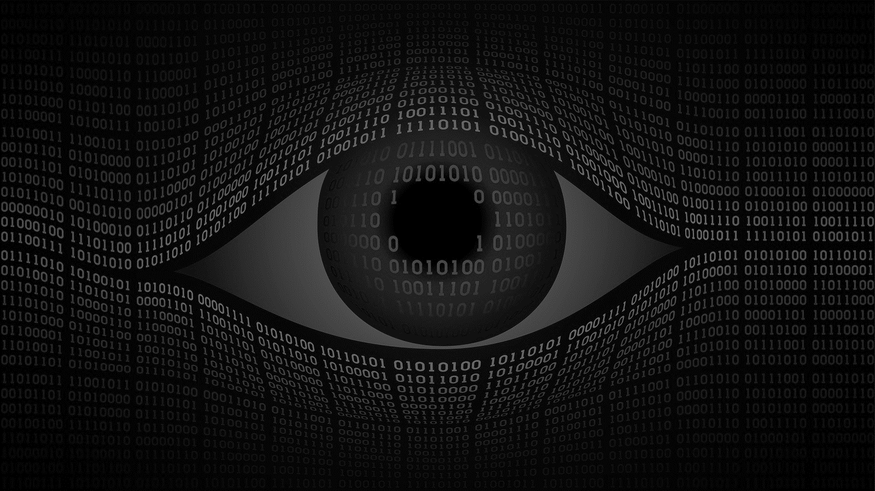

QUT Business Analysis
and
Data Science Club
Computer Vision
Workshop
17th of September

Slide 2





What we stand for
Industry
©
Bridging the gap
Between
the Industry and Academics
Notes:
Here we are. Students at QUT. And there is the industry somewhere pretty far from us. QUT BANDS stands in the middle to create a platform for networking where “we” can ask questions and where “they” can share their experience. Believe me, industry people are really looking forward to meet talented students.

Slide 3
Today’s menu
Shapes and Image representation
Perceptron
Multilayer Perceptron
Convolutional Neural Network
Pizza Time

Slide 4
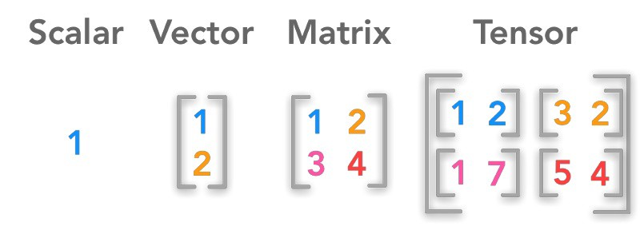
Shapes

Slide 5
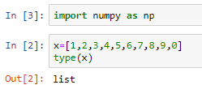
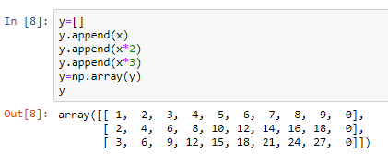
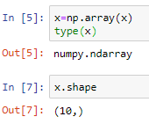
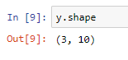
Shapes

Slide 6
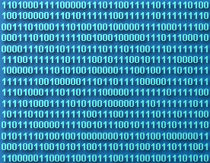

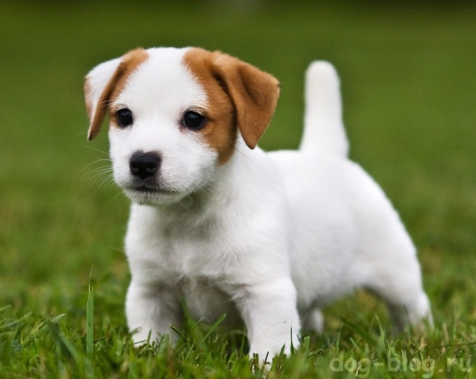
What about images?

Slide 7
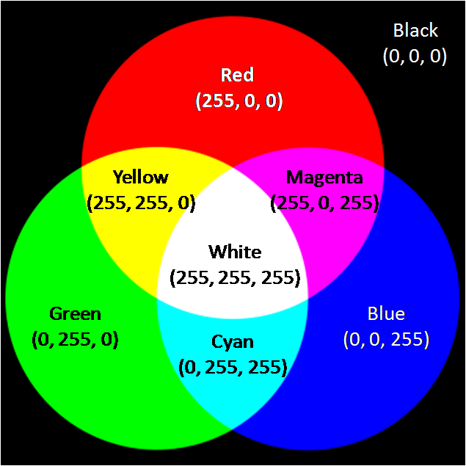
What about images?
https://towardsdatascience.com/image-classifier-cats-vs-dogs-with-convolutional-neural-networks-cnns-and-google-colabs-4e9af21ae7a8

Slide 8
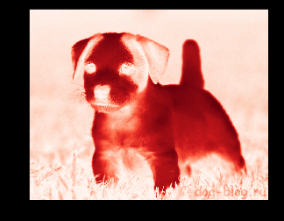
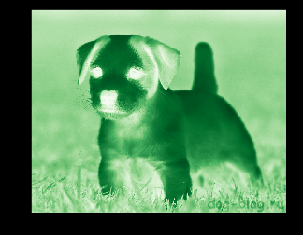
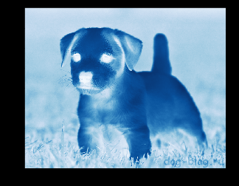
Representation of images
Red Green Blue
(R,G,B)
(15, 240,150)
0 - 255

Slide 9
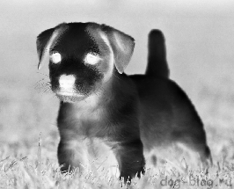
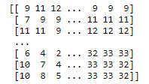
Representation of images
Green
height
Shape = ?
Shape=(height,width)
width

Slide 10

Representation of Images
(3,height,width)
(height,width,3)

Slide 11
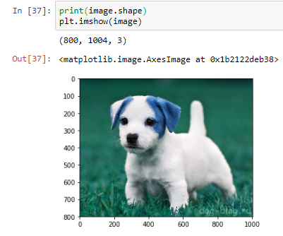

Representation of images

Slide 12
x – variable
[x1,x2,x3…xn] – vector
[[x11,x12,x13…x1n]
[x21,x22,x23…x2n]
…
[xm1,xm2,xm3..xmn]] – Matrix

Slide 13
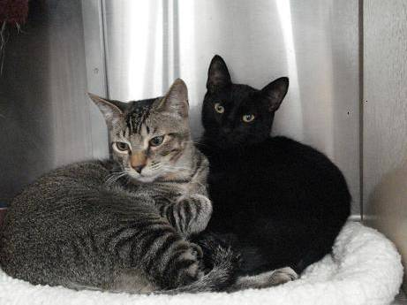
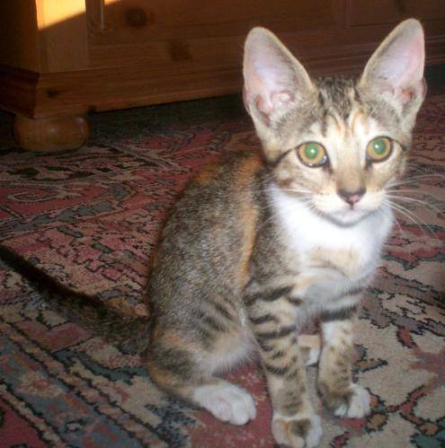
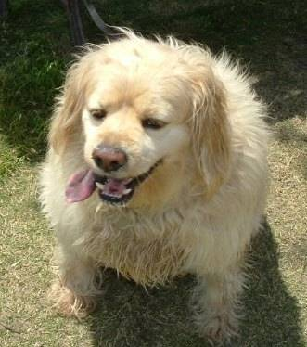
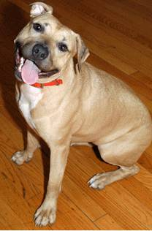
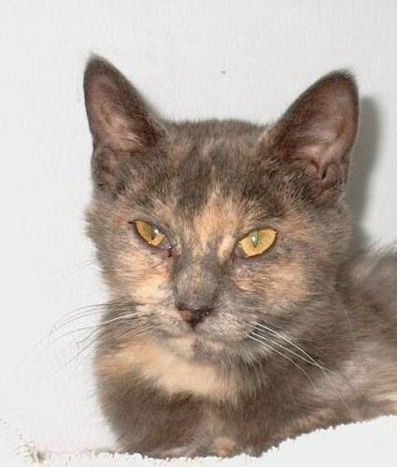
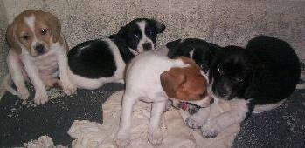

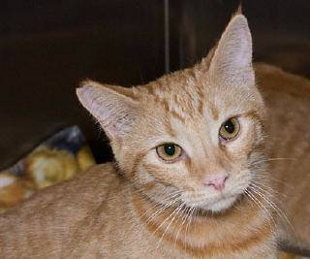
Representation of Images
1000 images
Height=240
Width = 320
Shape = ????
Image1
Image2
Image3
Image4
…..
image100500
height
channels
( 1000, 240 ,320 ,3 )
BATCH
qty
width

Slide 14

MNIST

Slide 15
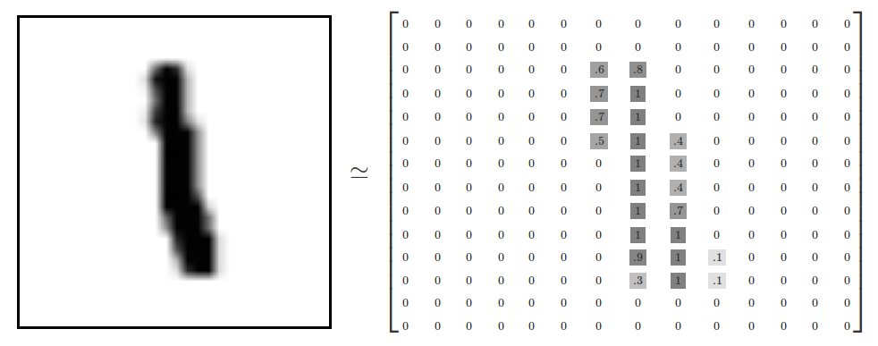
MNIST
https://tensorflow.rstudio.com/tensorflow/articles/tutorial_mnist_beginners.html

Slide 16

MNIST
Shape=?
(28,28)
(28,28,1) ???
28
(28,28,3)
28

Slide 17
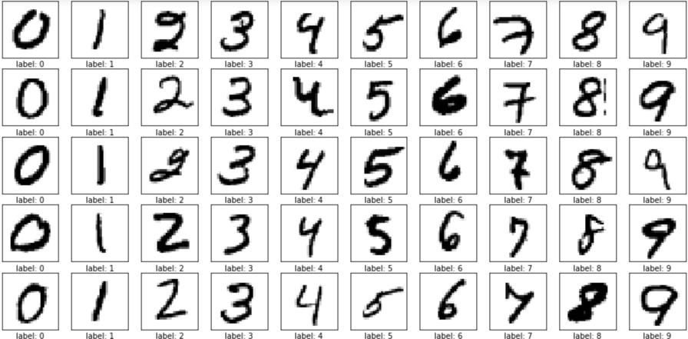

Recognition
Which digits can it belong to?
?
?
28
28
0,7 0 0,8 0,6 0,8 0,5 0,8 0,2 0,7 0,4

Slide 18

Recognition
0
How many
Weights?
0,2
1
0,20,5
0,4
0,6
…..
0,8
2
3
. . . .
. . . .
8
9
0
784*10=7840
28
Perceptron
28
(784,)

Slide 19
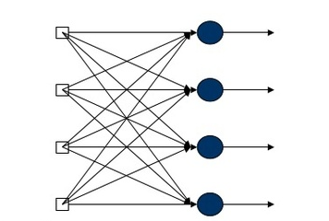

Perceptron
0,1
0,1
0,1
0,1
0,1
0,1
0,1
0,1
0,1
0,1
0
0
0
0
0
0
0
1
0
0
Layer
Softmax
Input Tensor Output tensor
(784,)
(10,)
NO!!!

Slide 20

Jumpin’ to Python
www.colab.research.google.com

Slide 21
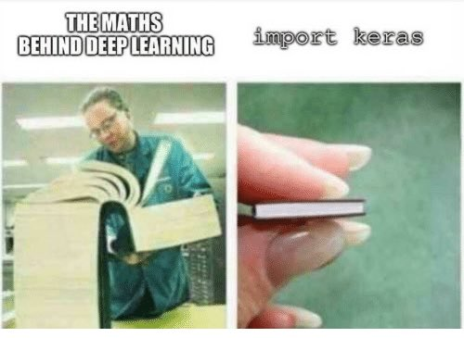

Slide 22
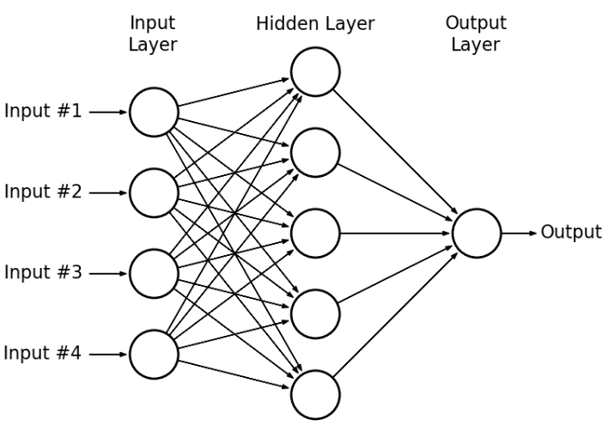
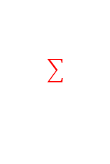
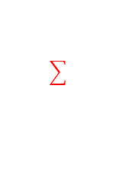
Multi layer perceptron
weights
weights

Slide 23

Multi layer Perceptron
https://youtu.be/3JQ3hYko51Y?t=48

Slide 24
Jumpin’ to Python
www.colab.research.google.com

Slide 25
Multi layer perceptron

Slide 27

Convolutional Neural Network

Slide 28
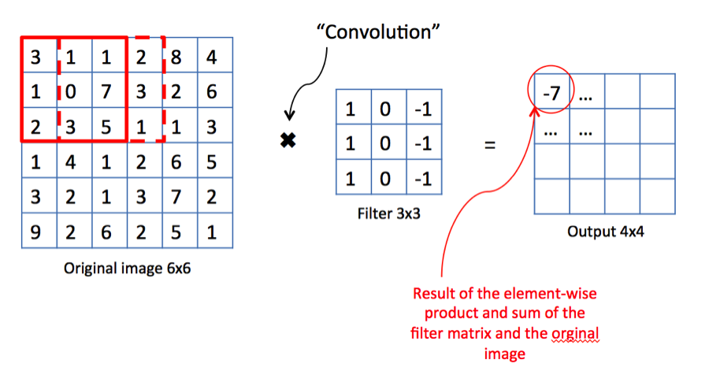
Convolutional Neural Networks

Slide 29

Excel time!

Slide 30
Convolutional Neural Network

Slide 31
Convolutional Neural Network
https://youtu.be/3JQ3hYko51Y?t=85

Slide 32
Convolutional Neural Network
Corner horisontal line corner
vertical line vertical line
Corner horisontal line corner

Slide 33
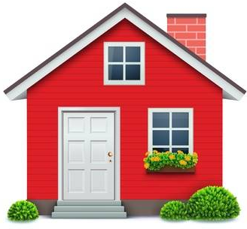
Convolutional Neural Network
BOX?
Triangle
BOX
BOX
BOX
BOX
Green
stuff
Green
stuff
Green
stuff

Slide 34
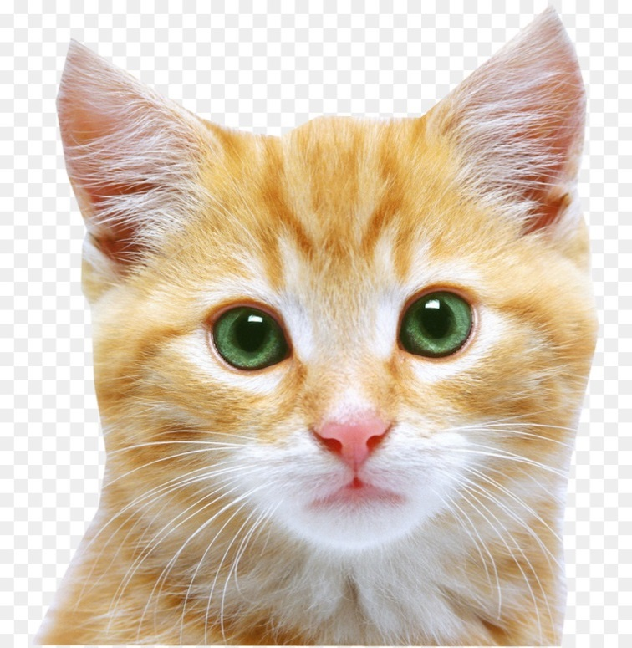
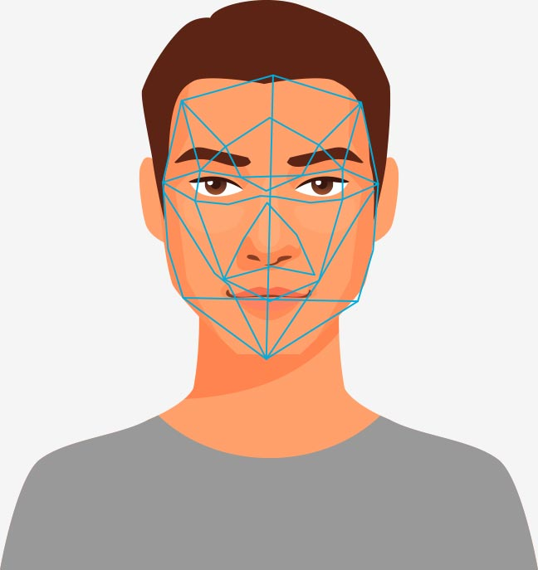
Convolutional Neural Network
ear
ear
eye
eye
nose
mouth

Slide 35
Convolutional Neural Network
head
tail
body
leg
leg leg

Slide 36
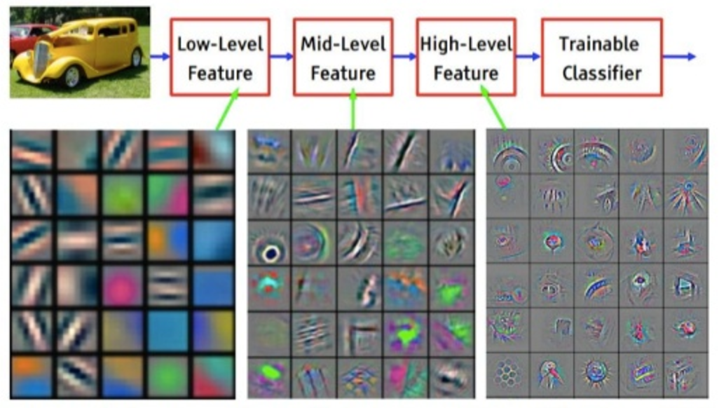
https://towardsdatascience.com/image-classifier-cats-vs-dogs-with-convolutional-neural-networks-cnns-and-google-colabs-4e9af21ae7a8

Slide 37
Jumpin’ to Python

Slide 38
99%.. Not bad…. Not perfect
How to improve??
Increase the dataset
More hidden Layers
More neurons in hidden layers
More epochs
Data Augmentation

Slide 39










Slide 40
Welcome to the Club
Facebook -> QUT BANDS

Slide 41




Thank you for your attention!
Q & A
https://github.com/MenshikovDmitry/cv_workshop_MNIST

